Slide 1
What is Exception?

Slide 2
Exception: An Unwanted Unexpected Event That Disturbs Normal Flow Of The Program Is Called Exception. Example: Sleepingexception Tyrepunchuredexception Filenotfoundexception ...Etc

Slide 3
What is Exception Handling ?

Slide 4
Exception Handling Doesn't Mean Repairing An Exception. We Have To Define Alternative Way To Continue Rest Of The Program Normally. This Way Of Defining Alternative Is Nothing But Exception Handling

Slide 5
try { read data from london file } catch(filenotfoundexception e) { use local file and continue rest of the program normally }

Slide 6
What is activation record" (or) "stack frame?

Slide 7
For Every Thread Jvm Will Create A Separate Stack At The Time Of Thread Creation. All Method Calls Performed By That Thread Will Be Stored In That Stack. Each Entry In The Stack Is Called "Activation Record" (Or) "Stack Frame"

Slide 8
class test { public static void main(string[] args) { dostuff(); } public static void dostuff() { domorestuff(); } public static void domorestuff() { system.out.println("hello"); } } output: hello

Slide 9
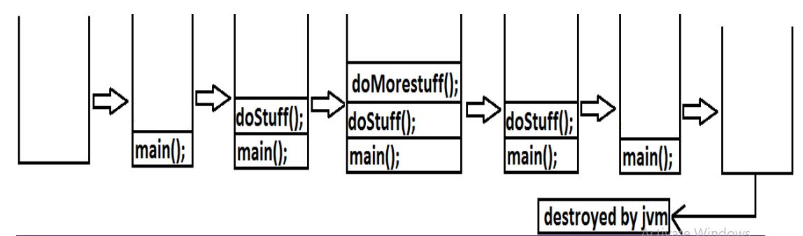

Slide 10
Default Exception Handling In Java?

Slide 11
if an exception raised inside any method then that method is responsible to create exception object with the following information. 1. name of the exception. 2. description of the exception. 3. location of the exception.(stacktrace)

Slide 12
class test { public static void main(string[] args) { dostuff(); } public static void dostuff() { domorestuff(); } public static void domorestuff() { system.out.println(10/0); } } output: exception in thread "main" java.lang.arithmeticexception: / by zero attest.domorestuff(test.java:10) attest.dostuff(test.java:7) attest.main(test.java:4)

Slide 13
which class acts as a root for exception hierarchy. And there two child classes?

Slide 14
What Is Difference Between Exception And Error?

Slide 15
Exception: Most Of The Cases Exceptions Are Caused By Our Program And These Are Recoverable. Ex : If Filenotfoundexception Occurs Then We Can Use Local File And We Can Continue Rest Of The Program Execution Normally. Error: Most Of The Cases Errors Are Not Caused By Our Program These Are Due To Lack Of System Resources And These Are Non-recoverable. Ex :If Outofmemoryerror Occurs Being A Programmer We Can't Do Anything The Program Will Be Terminated Abnormally.System Admin Or Server Admin Is Responsible To Raise/Increase Heap Memory.

Slide 16
Checked Vs Unchecked Exceptions:

Slide 17
The Exceptions Which Are Checked By The Compiler Whether Programmer Handling Or Not, For Smooth Execution Of The Program At Runtime, Are Called Checked Exceptions. 1. Hallticketmissingexception 2. Pennotworkingexception 3. Filenotfoundexception

Slide 18
The exceptions which are not checked by the compiler whether programmer handing or not ,are called unchecked exceptions 1. BombBlastException 2. ArithmeticException 3. NullPointerExceptio

Slide 19
Note:runtimeexception And Its Child Classes, Error And Its Child Classes Are Unchecked And All The Remaining Are Considered As Checked Exceptions. Note: Whether Exception Is Checked Or Unchecked Compulsory It Should Occurs At Runtime Only And There Is No Chance Of Occurring Any Exception At Compile Time.

Slide 20
Fully checked Vs Partially checked

Slide 21
a checked exception is said to be fully checked if and only if all its child classes are also checked. example: 1) ioexception 2) interruptedexception a checked exception is said to be partially checked if and only if some of its child classes are unchecked. example: exception note :the only possible partially checked exceptions in java are: 1. throwable. 2. exception

Slide 22
Runtimeexception-----unchecked 2. Error-----unchecked 3. Ioexception-----fully Checked 4. Exception-----partially Checked 5. Interruptedexception-----fully Checked 6. Throwable------partially Checked 7. Arithmeticexception ----- Unchecked 8. Nullpointerexception ------ Unchecked 9. Filenotfoundexception ----- Fully Checked

Slide 23
RuntimeException-----unchecked 2. Error-----unchecked 3. IOException-----fully checked 4. Exception-----partially checked 5. InterruptedException-----fully checked 6. Throwable------partially checked 7. ArithmeticException ----- unchecked 8. NullPointerException ------ unchecked 9. FileNotFoundException ----- fully checked

Slide 24
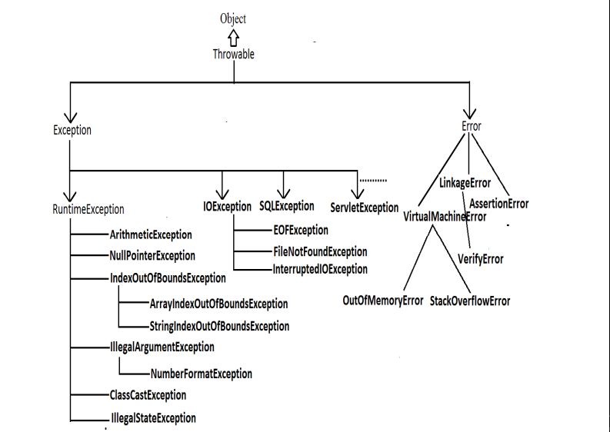

Slide 25
What is Risky code?

Slide 26
In Our Program The Code Which May Raise Exception Is Called Risky Code, We Have To Place Risky Code Inside Try Block And The Corresponding Handling Code Inside Catch Block

Slide 27
Try { Risky Code } Catch(exception E) { Handling Code }

Slide 28
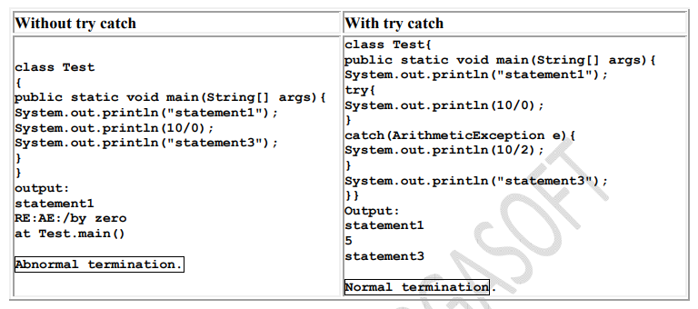

Slide 29
Try { statement1; statement2; statement3; } catch(X e) { statement4; } statement5;

Slide 30
Various Methods To Print Exception Information?

Slide 31
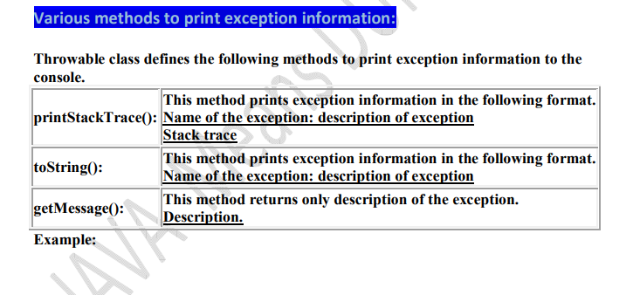

Slide 32
class test { public static void main(string[] args) { try { system.out.println("try block executed"); } catch(arithmeticexception e) { system.out.println("catch block executed"); } finally { system.out.println("finally block executed"); } } }

Slide 33
class test { public static void main(string[] args) { try { system.out.println("try block executed"); system.out.println(10/0); } catch(arithmeticexception e) { system.out.println("catch block executed"); } finally { system.out.println("finally block executed"); } } }

Slide 34
output: try block executed catch block executed finally block executed

Slide 35
class test { public static void main(string[] args) { try { system.out.println("try block executed"); system.out.println(10/0); } catch(nullpointerexception e) { system.out.println("catch block executed"); } finally { System.out.println("finally block executed"); } } }

Slide 36
output: try block executed finally block executed exception in thread "main" java.lang.arithmeticexception: / by zero at test.main(test.java:8)

Slide 37
return vs finally?

Slide 38
return vs finally: even though return statement present in try or catch blocks first finally will be executed and after that only return statement will be considered. i.efinally block dominates return statement.

Slide 39
class test { public static void main(string[] args) { try { system.out.println("try block executed"); return; } catch(arithmeticexception e) { system.out.println("catch block executed"); } finally { system.out.println("finally block executed"); } } }

Slide 40
Output: try block executed Finally block executed

Slide 41
class test { public static void main(string[] args) { system.out.println(m1()); } public static intm1() { try { system.out.println(10/0); return 777; } catch(arithmeticexception e) { return 888; } finally { return 999; } } }

Slide 42
Output: 999

Slide 43
Difference Between Final, Finally, And Finalize

Slide 44
final: final is the modifier applicable for classes, methods and variables. if a class declared as the final then child class creation is not possible. if a method declared as the final then overriding of that method is not possible. if a variable declared as the final then reassignment is not possible.

Slide 45
finally: • finally is the block always associated with try-catch to maintain clean up code which should be executed always irrespective of whether exception raised or not raised and whether handled or not handled

Slide 46
finalize is a method, always invoked by Garbage Collector just before destroying an object to perform cleanup activities

Slide 47
try { stmt 1; stmt-2; stmt-3; } catch(exception e) { stmt-4; } finally { stmt-5; } stmt-6;

Slide 48
public class Exceptions {
public static void main(String[] args) {
try
{
System.out.println("1");
System.out.println("2");
System.out.println("3");
try
{
System.out.println("4");
System.out.println("5");
System.out.println("6");
}
catch (ArithmeticException e)
{
System.out.println("7");
}
}
finally
{
System.out.println("8");
}
System.out.println("9");
}
catch (ArithmeticException ae)
{
System.out.println("10");
}
finally
{
System.out.println("11");
}
System.out.println("12");
}

Slide 49
1
2
3
4
5
6
8
9
11
12

Slide 50
public class Exceptions {
public static void main(String[] args) {
try
{
System.out.println(10/0);
System.out.println("2");
System.out.println("3");
try
{
System.out.println("4");
System.out.println("5");
System.out.println("6");
}
catch (ArithmeticException e)
{
System.out.println("7");
}
}
finally
{
System.out.println("8");
}
System.out.println("9");
}
catch (ArithmeticException ae)
{
System.out.println("10");
}
finally
{
System.out.println("11");
}
System.out.println("12");
}

Slide 51
10
11
12

Slide 52
public class Exceptions {
public static void main(String[] args) {
try
{
System.out.println(“1”);
System.out.println("2");
System.out.println("3");
try
{
System.out.println(10/0);
System.out.println("5");
System.out.println("6");
}
catch (ArithmeticException e)
{
System.out.println("7");
}
}
finally
{
System.out.println("8");
}
System.out.println("9");
}
catch (ArithmeticException ae)
{
System.out.println("10");
}
finally
{
System.out.println("11");
}
System.out.println("12");
}

Slide 53
1
2
3
7
8
9
11
12

Slide 54
public class Exceptions {
public static void main(String[] args) {
try
{
System.out.println(10/0);
System.out.println("2");
System.out.println("3");
try
{
System.out.println(10/0);
System.out.println("5");
System.out.println("6");
}
catch (ArithmeticException e)
{
System.out.println("7");
}
}
finally
{
System.out.println("8");
}
System.out.println("9");
}
catch (ArithmeticException ae)
{
System.out.println("10");
}
finally
{
System.out.println("11");
}
System.out.println("12");
}

Slide 55
10
11
12

Slide 56
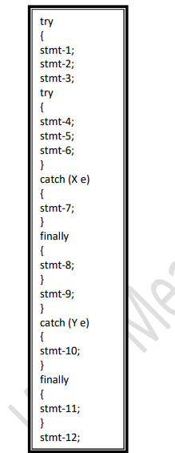

Slide 57
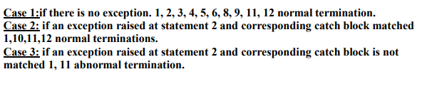

Slide 58
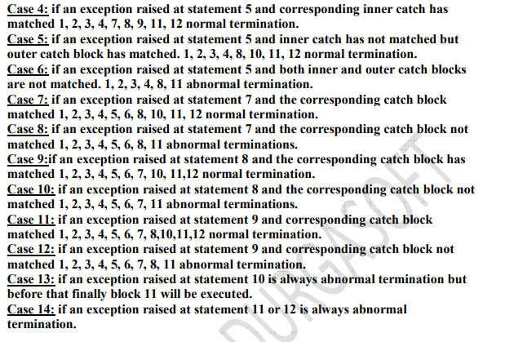

Slide 59
class test { public static void main(string[] args) { try { system.out.println(10/0); } catch(arithmeticexception e) { system.out.println(10/0); } finally{ string s=null; system.out.println(s.length()); } } }

Slide 60
output : RE:NullPointerException

Slide 61
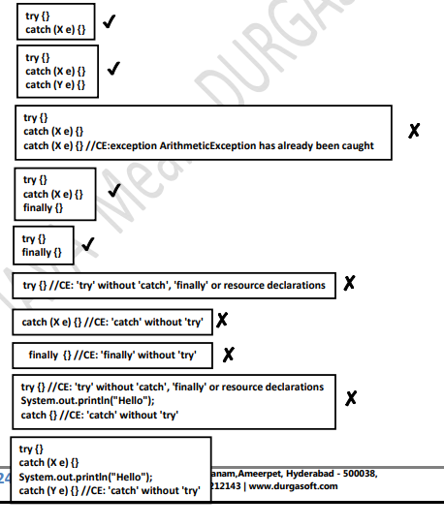

Slide 62

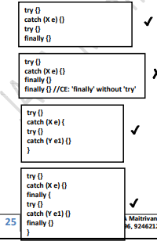

Slide 63
throw statement:

Slide 64
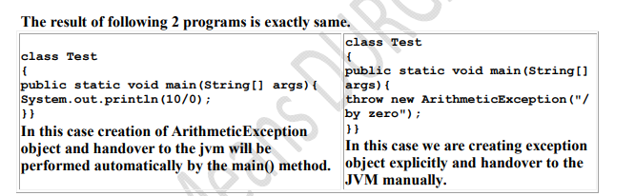

Slide 65
class tooyoungexception extends runtimeexception { tooyoungexception(string s) { super(s); } } class toooldexception extends runtimeexception { toooldexception(string s) { super(s); } } class customizedexceptiondemo { public static void main(string[] args) { int age=integer.parseint(args[0]); if(age>60) { throw new tooyoungexception("please wait some more time.... u will get best match"); } else if(age<18) { { throw new toooldexception("u r age already crossed....no chance of getting married"); } else { system.out.println("you will get match details soon by e-mail"); }}} }

Slide 66
e:\scjp>java customizedexceptiondemo 61 exception in thread "main" tooyoungexception: please wait some more time.... u will get best match at customizedexceptiondemo.main(customizedexceptiondemo.java:21)

Slide 67
Arrayindexoutofboundsexception(aioobe)?

Slide 68
class Test{ public static void main(String[] args){ int[] x=new int[10]; System.out.println(x[0]);//valid System.out.println(x[100]);//AIOOBE System.out.println(x[-100]);//AIOOBE } }

Slide 69
NullPointerException (NPE).

Slide 70
Example: Class Test { Public Static Void Main(string[] Args) { String S=null; System.Out.Println(s.Length()); //R.E: Nullpointerexception } }

Slide 71
Stackoverflowerror:?

Slide 72
class test { public static void methodone() { methodtwo(); } public static void methodtwo() { methodone(); } public static void main(string[] args) { methodone(); } } output: run time error: stackoverfloeerror

Slide 73
Noclassdeffounderror?

Slide 74
It is the child class of Error and hence it is unchecked. JVM will raise this error automatically whenever it is unable to find required .class file. Example: java Test If Test.class is not available. Then we will get NoClassDefFound error.

Slide 75
Classcastexception?

Slide 76
it is the child class of runtimeexception and hence it is unchecked. raised automatically by the jvm whenever we are trying to type cast parent object to child

Slide 77
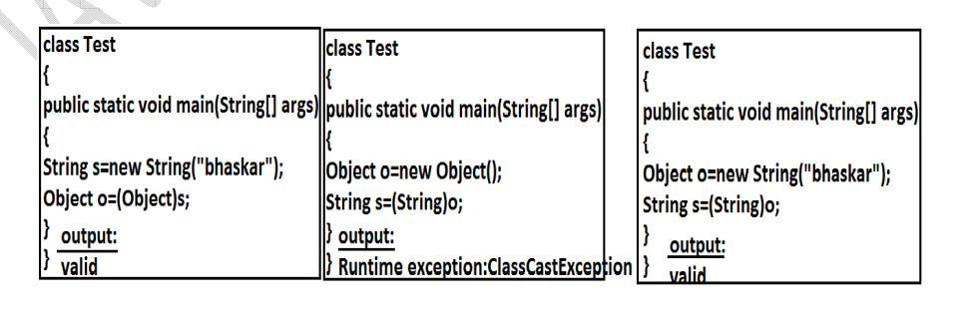

Slide 78
exceptionininitializererror:

Slide 79
It Is The Child Class Of Error And It Is Unchecked. Raised Automatically By The JVM, If Any Exception Occurs While Performing Static Variable Initialization And Static Block Execution. Example 1: Class Test{ Static Int I=10/0; }

Slide 80
Illegalargumentexception?

Slide 81
it is the child class of runtimeexception and hence it is unchecked. raised explicitly by the programmer (or) by the api developer to indicate that a method has been invoked with inappropriate argument. example: class test{ public static void main(string[] args){ thread t=new thread(); t.setpriority(10);//valid t.setpriority(100);//invalid }}

Slide 82
numberformatexception:

Slide 83
it is the child class of illegalargumentexception and hence is unchecked. raised explicitly by the programmer or by the api developer to indicate that we are attempting to convert string to the number. but the string is not properly formatted. example: class test { public static void main(string[] args) { int i=integer.parseint("10"); Int j=integer.parseint("ten"); }} output: runtime exception exception in thread "main" java.lang.numberformatexception: for input string: "ten"

Slide 84
IllegalStateException:

Slide 85
once session expires we can't call any method on the session object otherwise we will get illegalstateexception httpsession session=req.getsession(); system.out.println(session.getid()); session.invalidate(); system.out.println(session.getid()); // illgalstateexception

Slide 86
Throws Statement?

Slide 87
In Our Program If There Is Any Chance Of Raising Checked Exception Then Compulsory We Should Handle Either By Try Catch Or By Throws Keyword Otherwise The Code Won't Compile.

Slide 88
import java.io.*; class test3 { public static void main(string[] args) { printerwriter out=new printwriter("abc.txt"); out.println("hello"); } }

Slide 89
class test3 { public static void main(string[] args) { thread.sleep(5000); } }

Slide 90
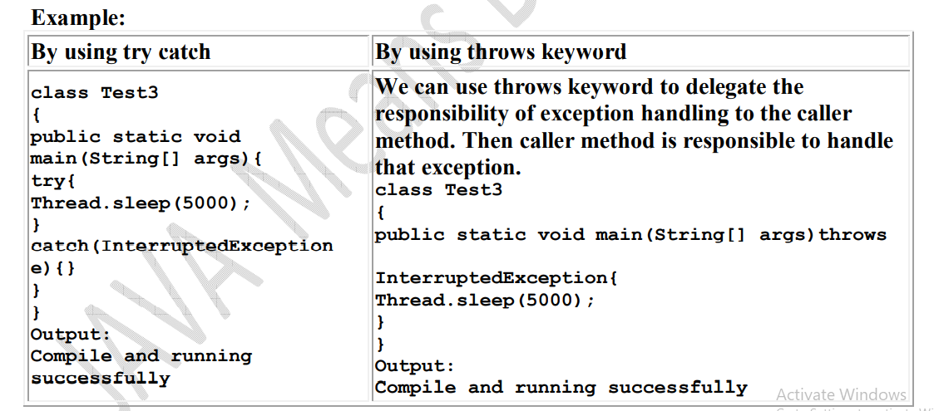

Slide 91
what are objectives of throws keywords

Slide 92
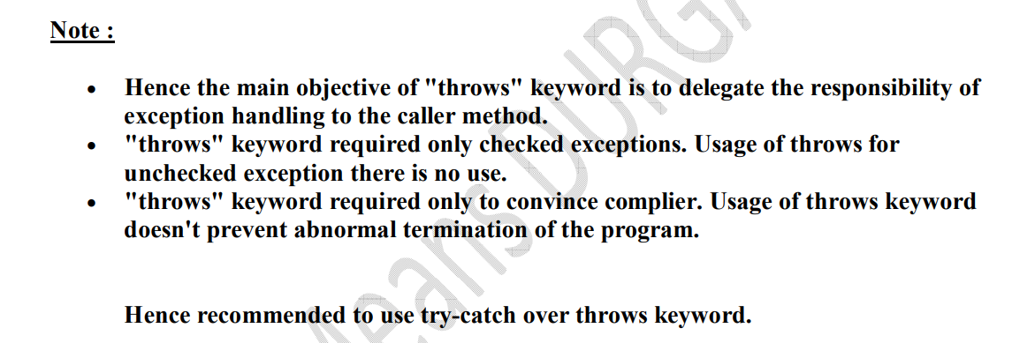

Slide 93
We Can Use Throws Keyword Only For Throwable Types Otherwise We Will Get Compile Time Error Saying Incompatible Types.

Slide 94
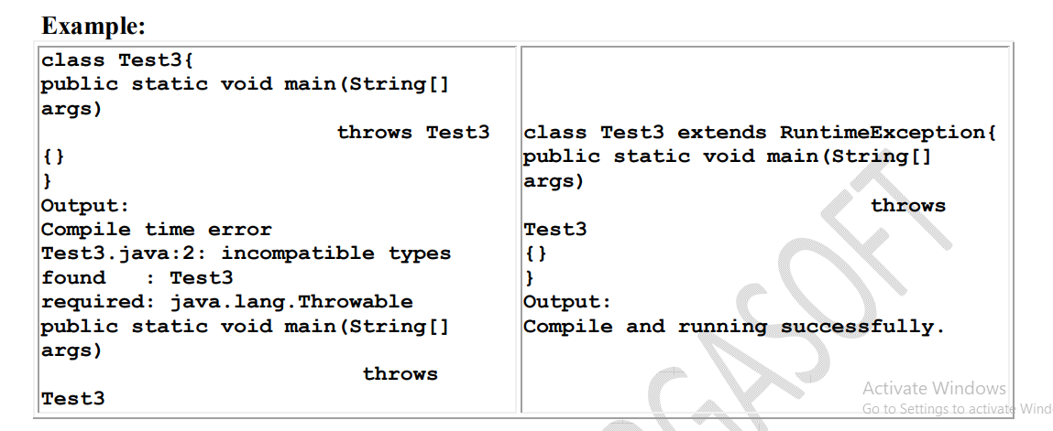

Slide 95
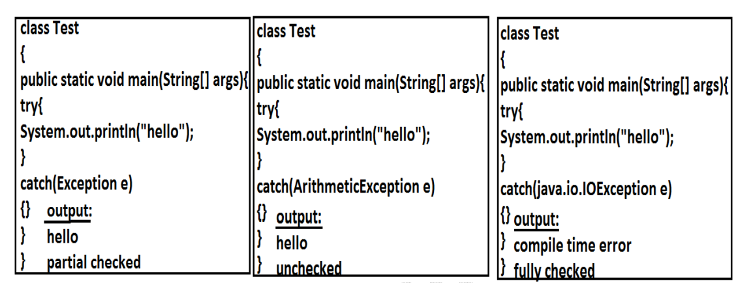

Slide 97
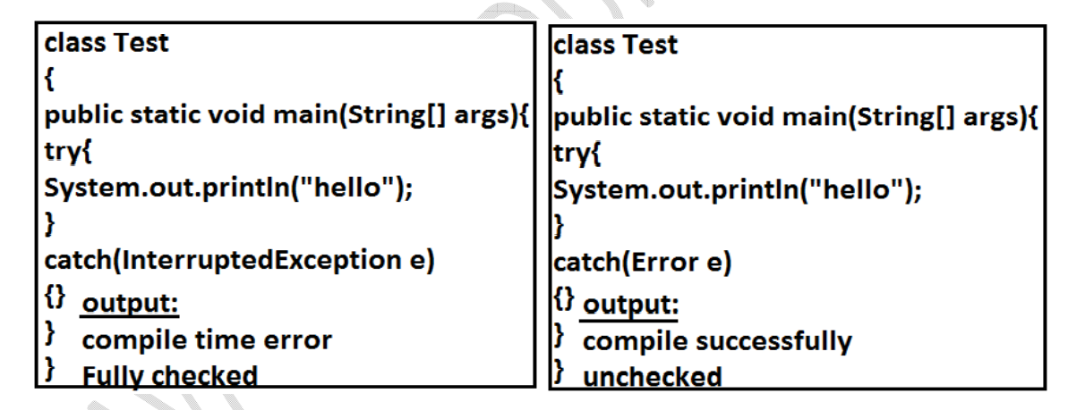

Slide 99
we can use throws keyword only for constructors and methods but not for classes.

Slide 100
Exception Handling Keywords Summary try catch finally throw throws

Slide 101
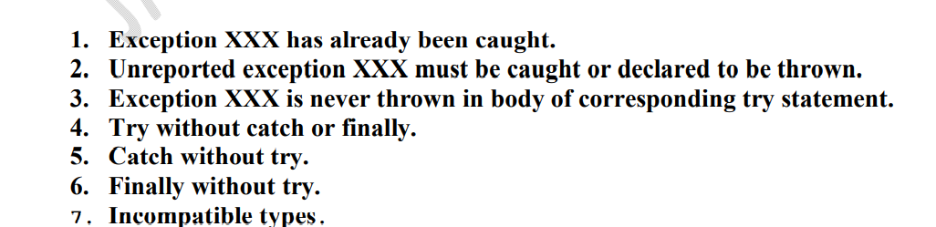


Slide 102
1.7 Version Enhansements :

Slide 103
1. try with resources 2. multi catch block

Slide 104
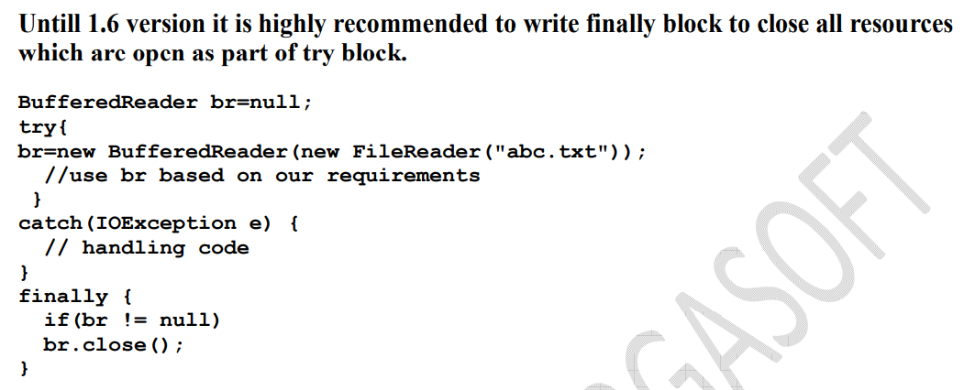

Slide 105
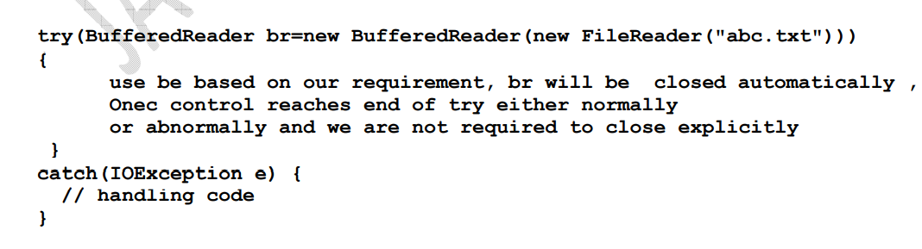

Slide 106
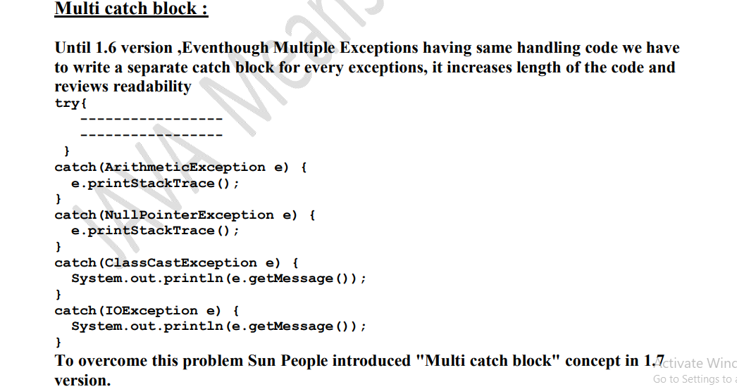

Slide 107
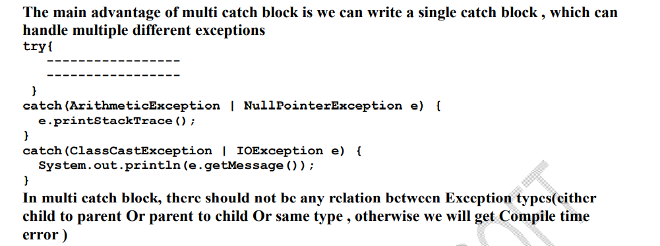

Slide 108
Exception Propagation

Slide 109
With In A Method If An Exception Raised And If That Method Doesn't Handle That Exception, Then Exception Object Will Be Propagated To The Caller Then Caller Method Is Responsible To Handle That Exceptions. This Process Is Called Exception Propagation.

Slide 110
Rethrowing An Exception :

Slide 111
